Slide 1
Welcome To My Project World

Slide 2
Project Name:
Web-Chat system.
AI Game: Rock-Paper-Scissor.
Game: Simple Snake game in C.
Library Management System.
Student Management System.

Slide 3
Web-Chat System:
Project Title: errorsolving.com
Language: PHP
Front-End: HTML, CSS
Back-End: PHP
Database: MySql
Server: Xampp

Slide 4
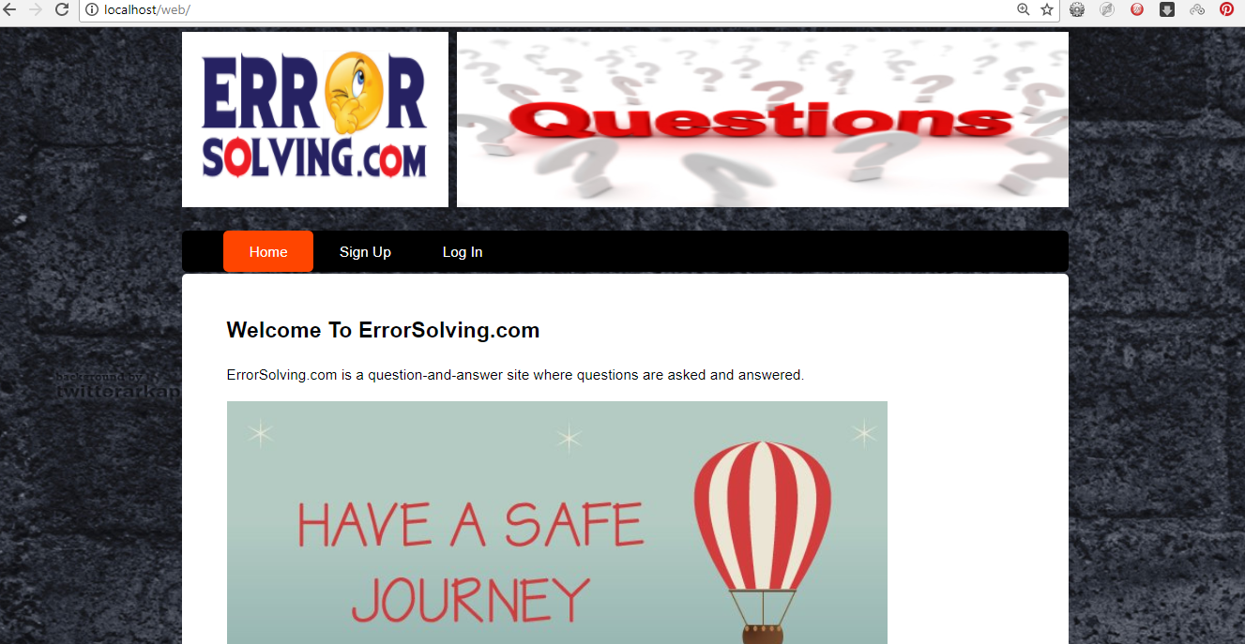
Website Home Page:

Slide 5
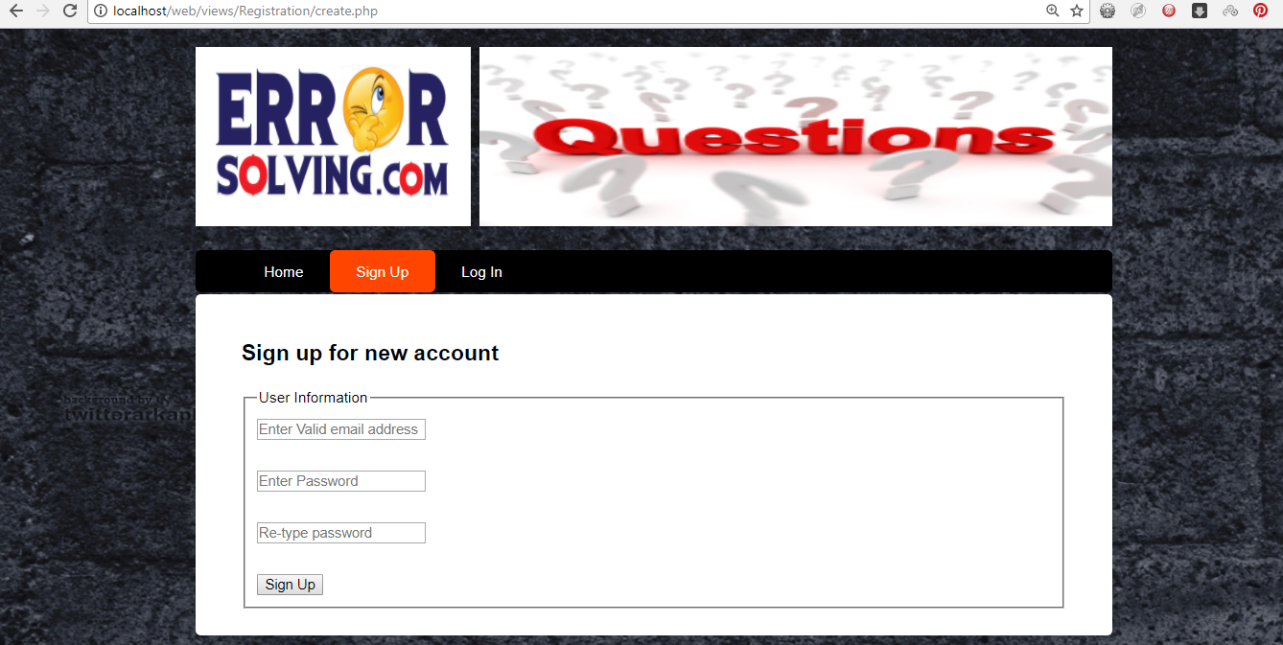
User Sign Up Form:

Slide 6
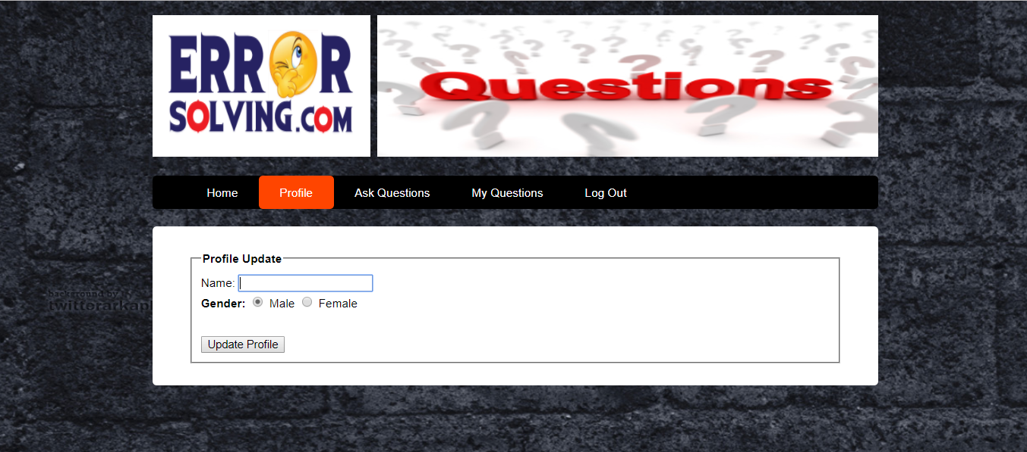
User Profile Updating page:

Slide 7
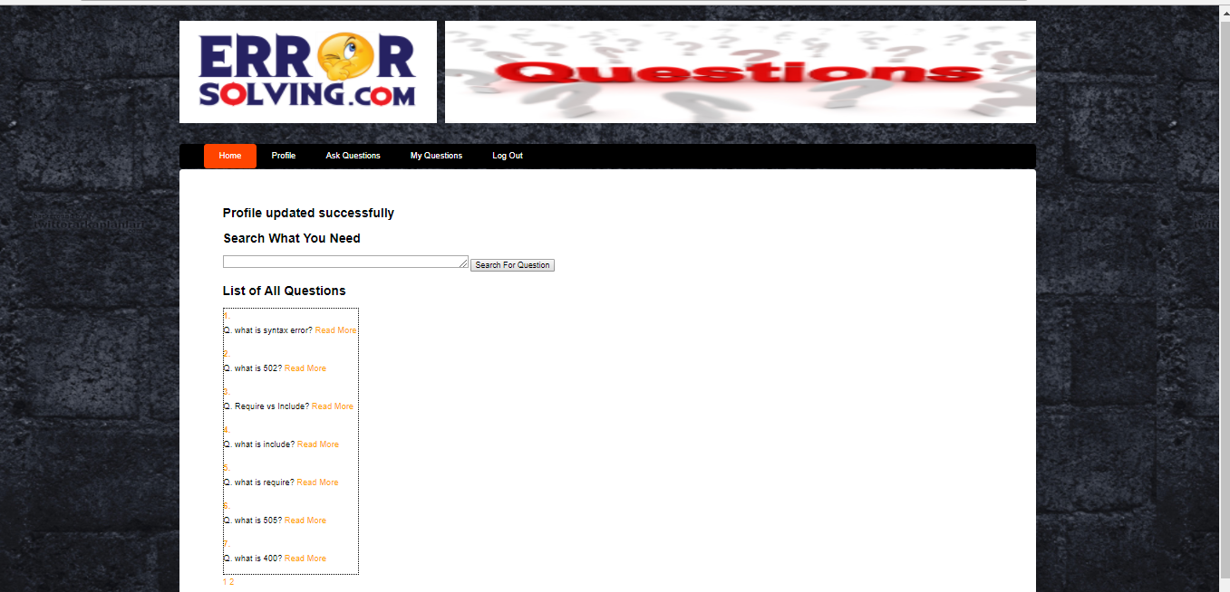
Home Page After Sign Up:

Slide 8
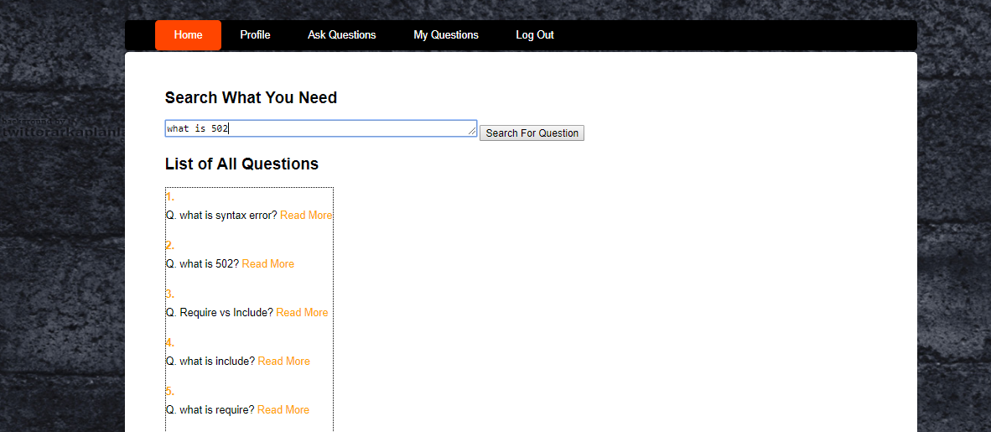
Search Option:

Slide 9
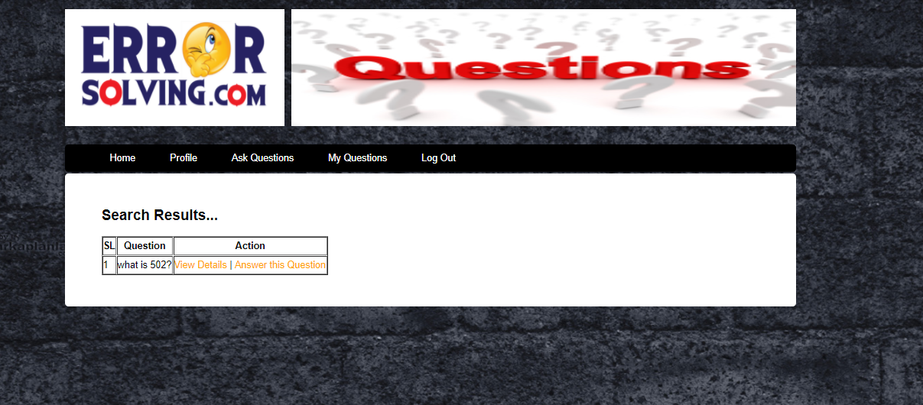
Search Result:

Slide 10
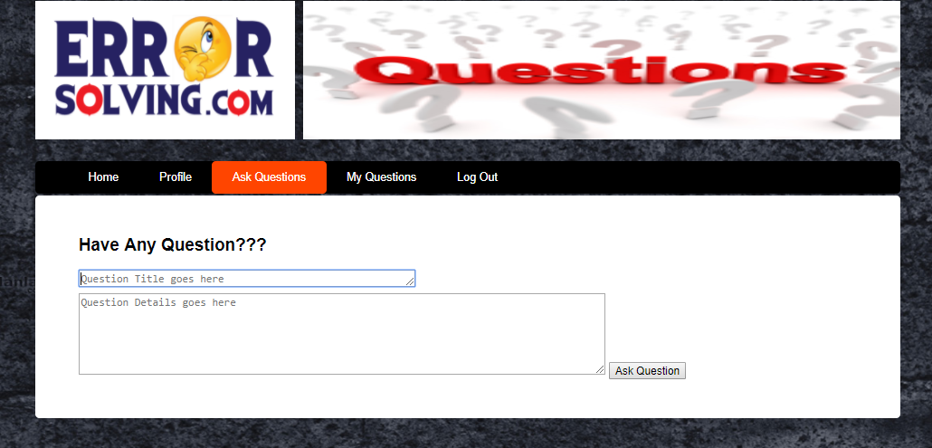
User Qus Field:

Slide 11
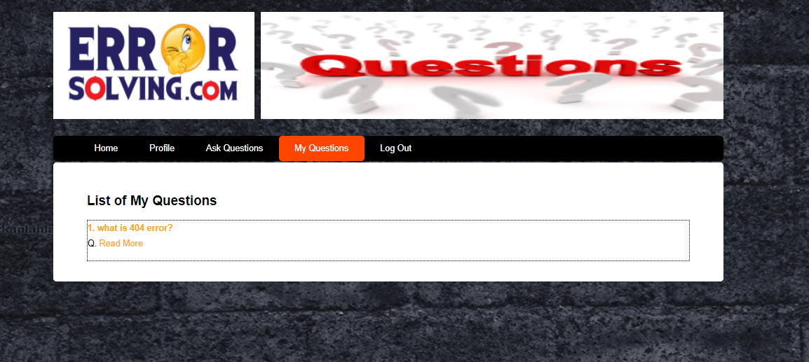
User Qus Store:

Slide 12
Rock Paper & Scissors Game:
Language: C
It is an artificial intelligence simple game.
Special function Using: SRAND

Slide 13
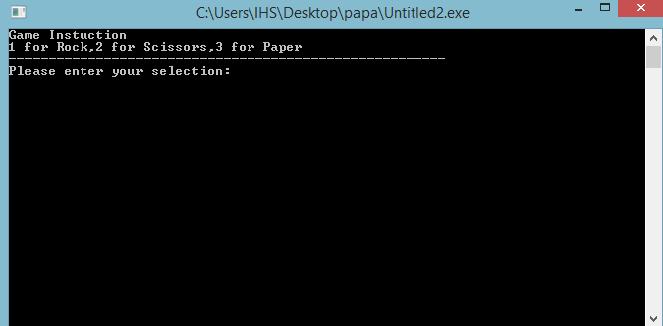
Some output in this game:

Slide 14
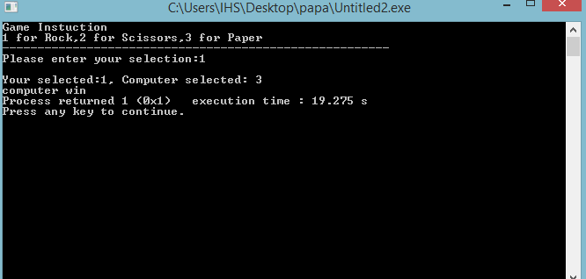
Input type: 1 that means Rock

Slide 15
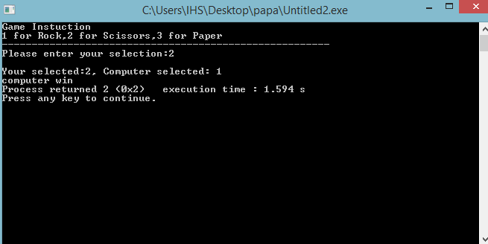
Input type: 2 means Scissors

Slide 16
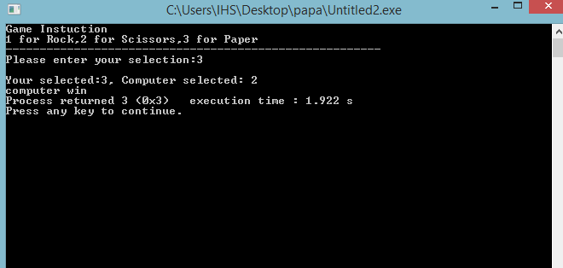
Input type: 3 means Paper

Slide 17
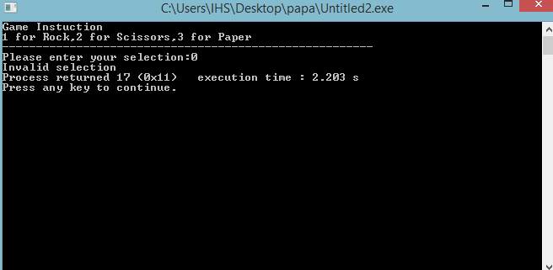
Input type: 0 that means wrong input.

Slide 18
Snake Game:
Language : C
This is a simple snake game.
Special Function: Bend, coordinate, Kbhit etc.

Slide 19
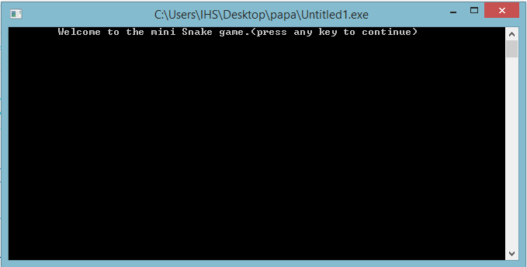
Output in Snake Game:

Slide 20
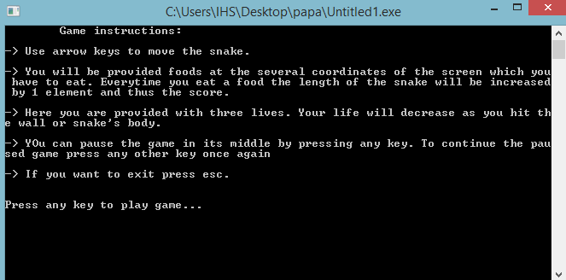

Slide 21
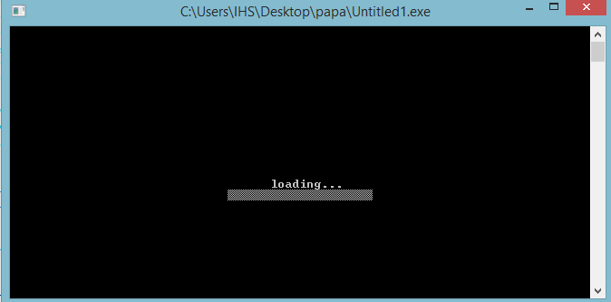

Slide 22
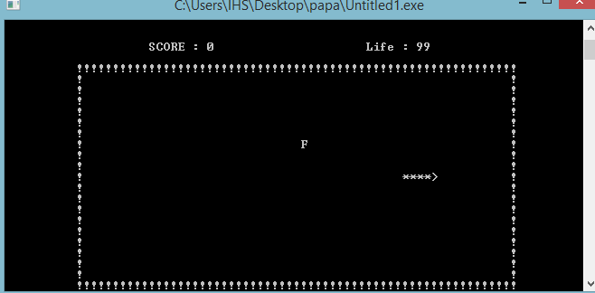

Slide 23
Library Management System: (Running)
Language: PHP
Front-End: HTML,CSS, Bootstrap
Back-End: PHP, JavaScript
Database: MySql
Server: Xampp

Slide 24
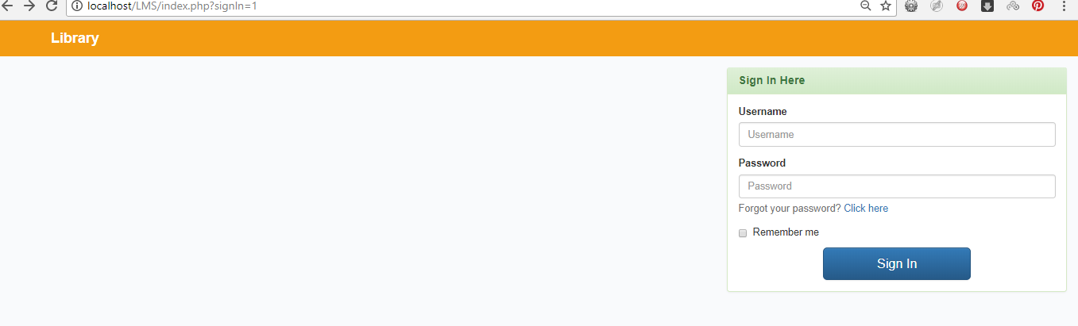
Admin Login Form:

Slide 25
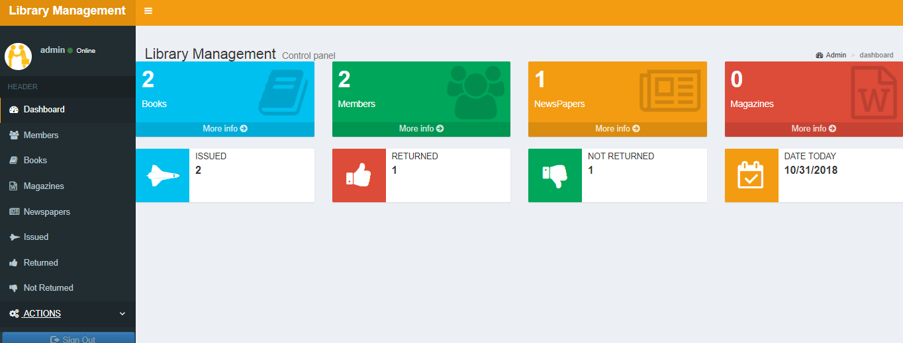
Dashboard:

Slide 26
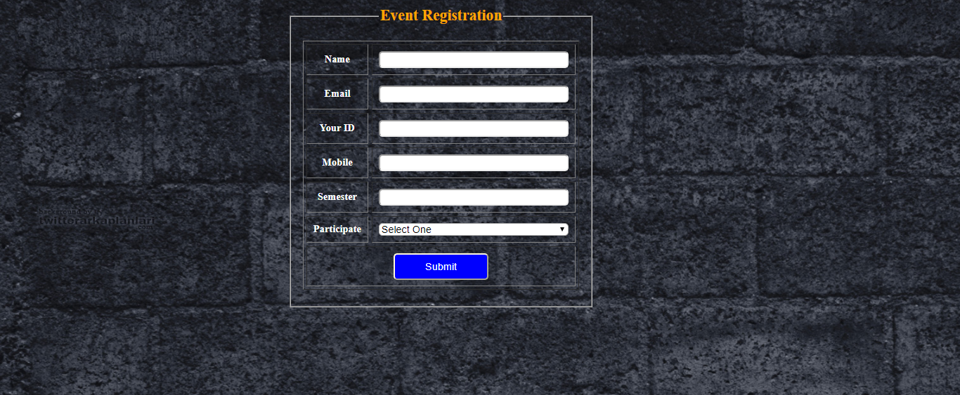
Library Event Registration:

Slide 27
University Management System:
Front- End: HTML,CSS, Bootstrap
Back – End: PHP, Javascript, Jquery
Database: MySql
Server: Xampp

Slide 28
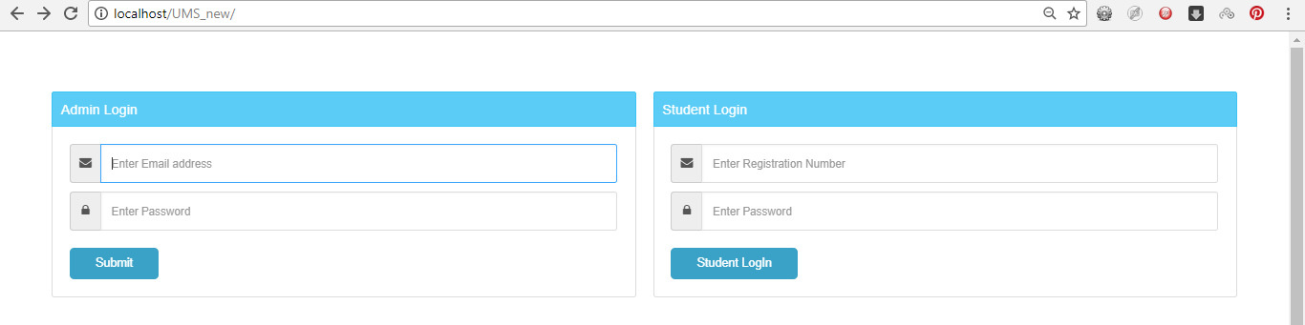
Login Page:

Slide 29
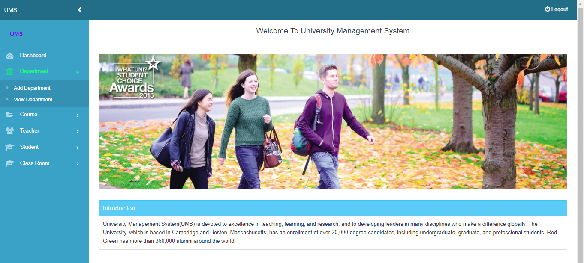
Dashboard:

Slide 30
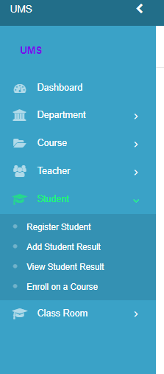
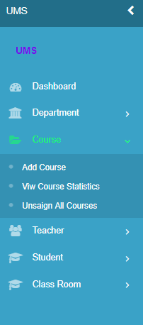
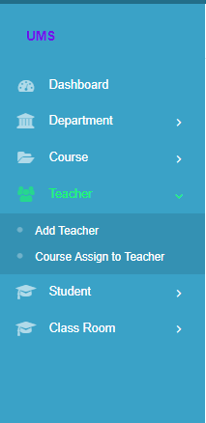
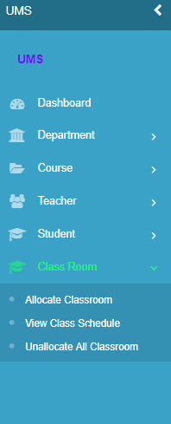
Some Features of this project:

Slide 31


